Slide 1
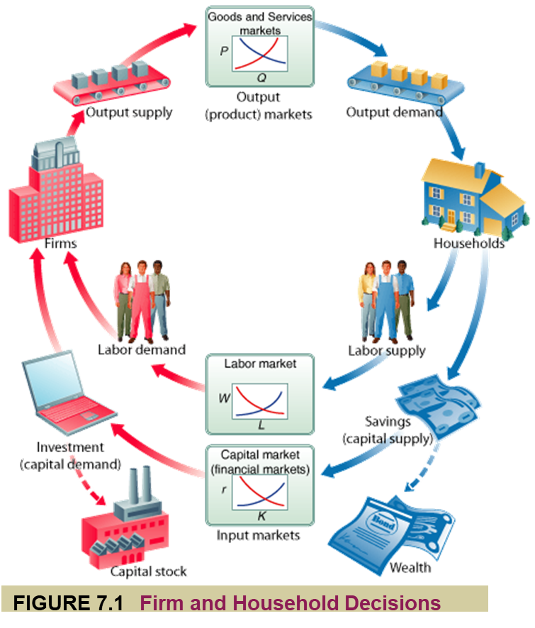
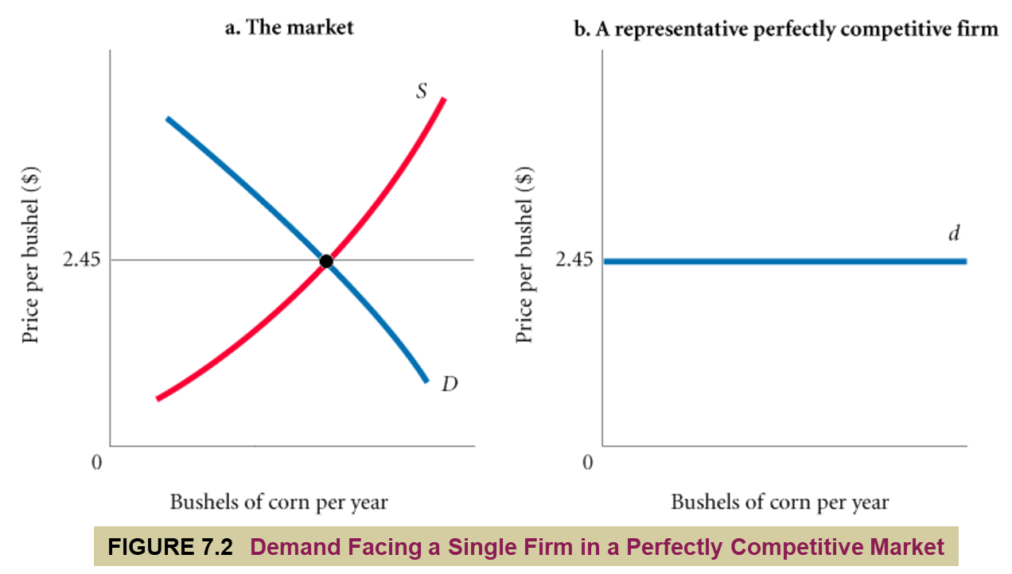
production
The process by which inputs are combined, transformed, and turned into outputs.
Production Is Not Limited to Firms
firm
An organization that comes into being when a person or a group of people decides to produce a good or service to meet a perceived demand. Most firms exist to make a profit.
perfect competition
An industry structure in which there are many firms, each small relative to the industry, producing virtually identical products and in which no firm is large enough to have any control over prices.
In perfectly competitive industries, new competitors can freely enter and exit the market.
homogeneous products
Undifferentiated products; products that are identical to, or indistinguishable from, one another.
<number> of 33

Slide 2
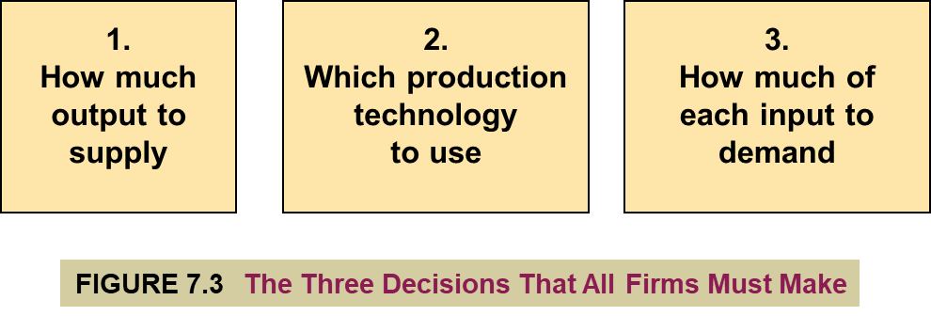
All firms must make several basic decisions to achieve what we assume to be their primary objective—maximum profits.
profit (economic profit)
The difference between total revenue and total cost.
profit = total revenue - total cost
total revenue
The amount received from the sale of the product (q x P).
total cost (total economic cost)
The total of
out-of-pocket costs,
normal rate of return on capital, and
opportunity cost of each factor of production.
The term profit will from here on refer to economic profit.
So whenever we say profit = total revenue - total cost, what we really mean is
economic profit = total revenue - total economic cost
<number> of 33

Slide 3
normal rate of return
A rate of return on capital that is just sufficient to keep owners and investors satisfied. For relatively risk-free firms, it should be nearly the same as the interest rate on risk-free government bonds.
TABLE 7.1 Calculating Total Revenue, Total Cost, and Profit
INITIAL INVESTMENT: MARKET INTEREST RATE AVAILABLE: | $20,000 0.10 OR 10%
Total revenue (3,000 belts x $10 each) | $30,000
Costs
Belts from Supplier | 15,000
Labor cost | 14,000
Normal return/Opportunity Cost of Capital ($20,000 x 0.10) | 2,000
Total Cost | $31,000
Profit = total revenue - total cost | −1,000
short run
The period of time for which two conditions hold:
1) The firm is operating under a fixed scale (fixed factor) of production, and
2) firms can neither enter nor exit an industry.
long run
That period of time for which there are no fixed factors of production:
1) Firms can increase or decrease the scale of operation, and
2) new firms can enter and existing firms can exit the industry.
<number> of 33

Slide 4
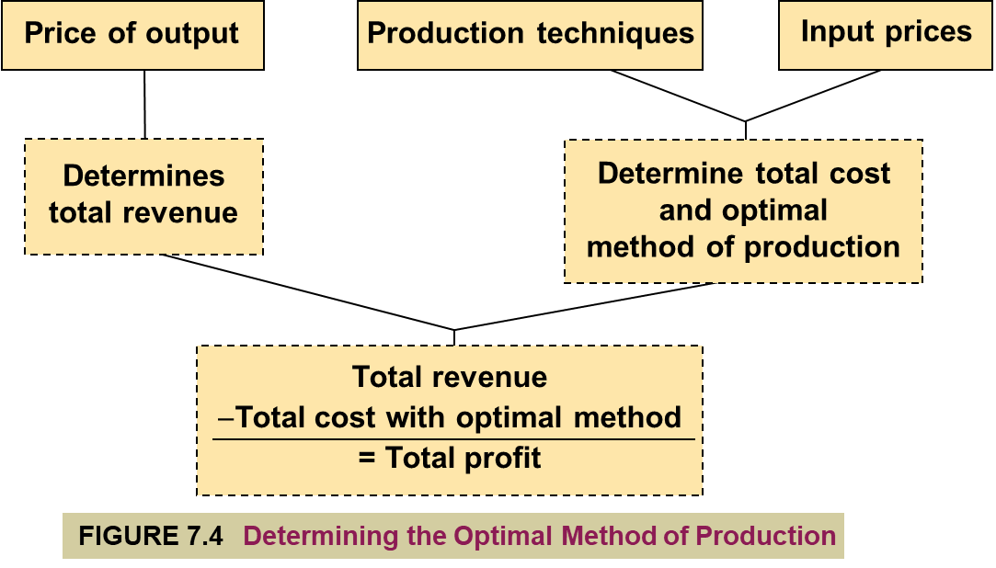
THE BASES OF DECISIONS: MARKET PRICE OF OUTPUTS, AVAILABLE TECHNOLOGY, AND INPUT PRICES
The bases of decision making:
1. The market price of output
2. The techniques of production that are available
3. The prices of inputs
Output price determines potential revenues. The techniques available tell me how much of each input I need, and input prices tell me how much they will cost. Together, the available production techniques and the prices of inputs determine costs.
optimal method of production
The production method that minimizes cost.
<number> of 33

Slide 5
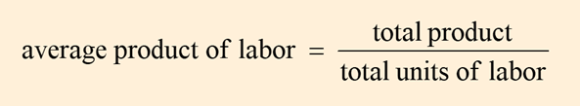
production technology
The quantitative relationship between inputs and outputs.
labor-intensive technology (economic welfare)
Technology that relies heavily on human labor instead of capital.
capital-intensive technology (cost effective)-(economic efficiency)
Technology that relies heavily on capital instead of human labor.
production function or total product function
A numerical or mathematical expression of a relationship between inputs and outputs.
It shows units of total product as a function of units of inputs.
marginal product
The additional output that can be produced by adding one more unit of a specific input, ceteris paribus.
law of diminishing returns
When additional units of a variable input are added to fixed inputs after a certain point, the marginal product of the variable input declines.
Diminishing returns always apply in the short run, and in the short run every firm will face diminishing returns.
This means that every firm finds it progressively more difficult to increase its output as it approaches capacity production.
average product
The average amount produced by each unit of a variable factor of production.
PRODUCTION FUNCTIONS WITH TWO VARIABLE FACTORS OF PRODUCTION
In general, additional capital increases the productivity of labor.
Because capital—buildings, machines, and so on—is of no use without people to operate it, we say that capital and labor are complementary inputs.

Slide 6
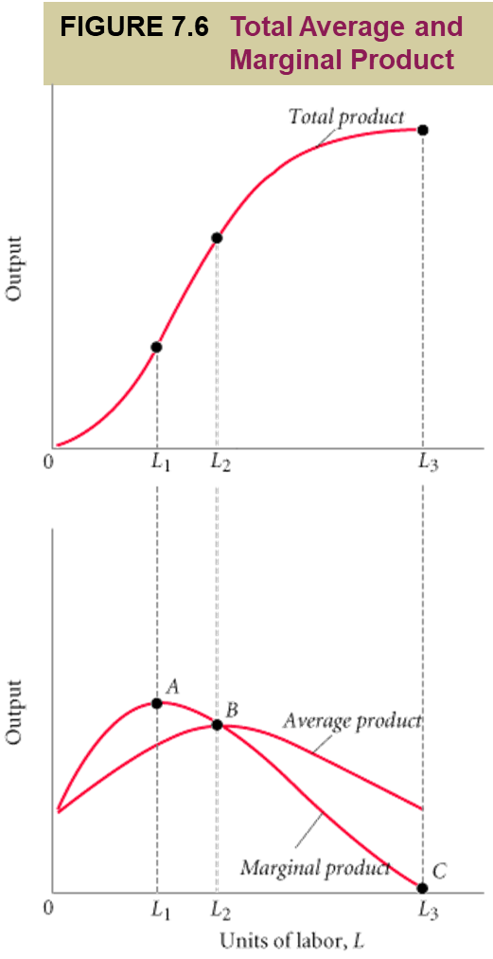
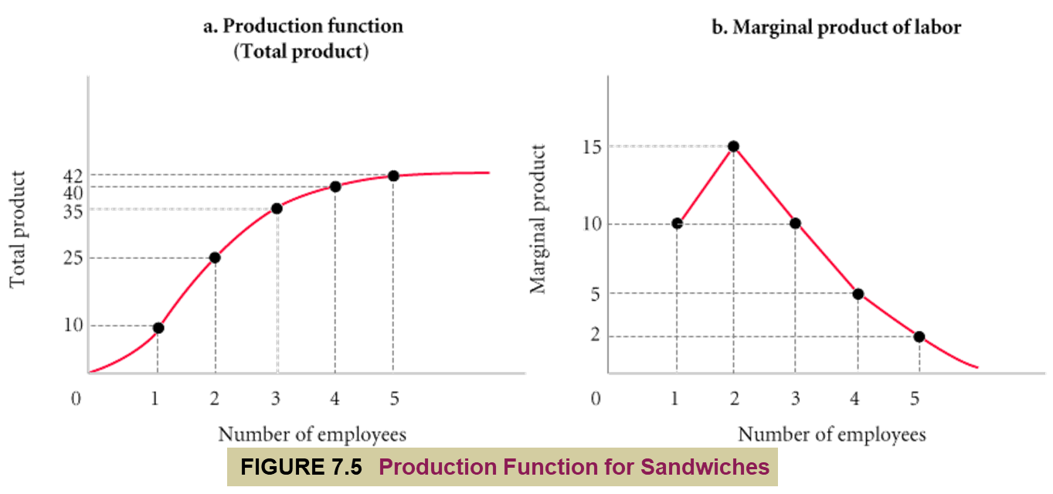
TABLE 7.2 Production Function
(1) LABOR UNITS EMPLOYEES | (2) TOTAL PRODUCT (SANDWICHES PER HOUR) | (3) MARGINAL PRODUCT OF LABOR | (4) AVERAGE PRODUCT OF LABOR (TOTAL PRODUCT LABOR UNITS)
0 1 2 3 4 5 6 | 0 10 25 35 40 42 42 | − 10 15 10 5 2 0 | − 10.0 12.5 11.7 10.0 8.4 7.0
<number> of 33

Slide 7
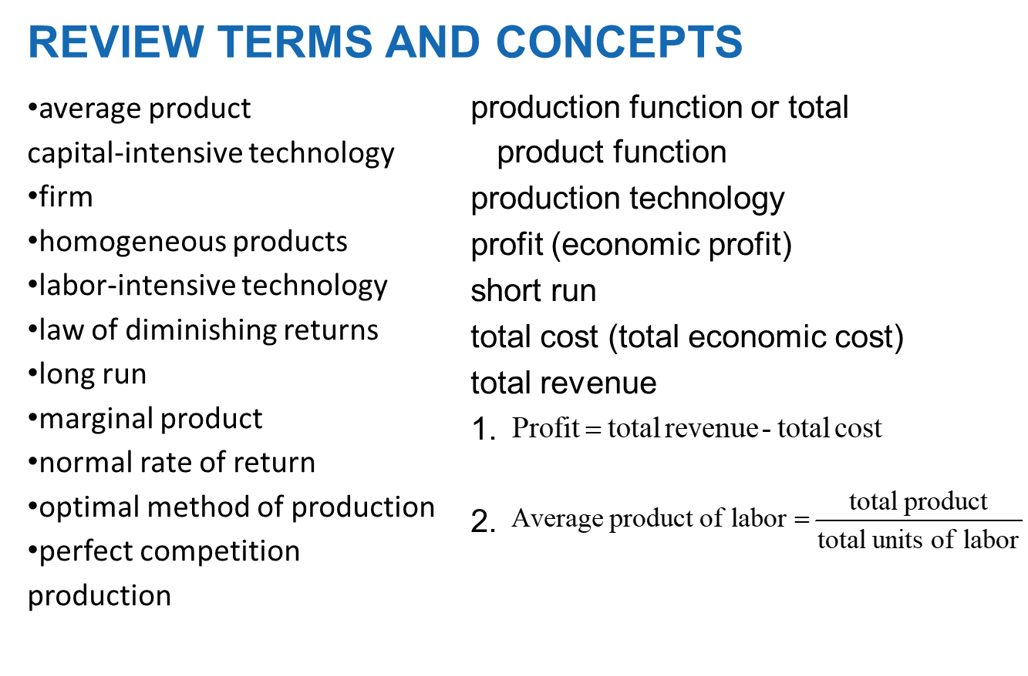
TABLE 7.3 Inputs Required to Produce 100 Diapers Using Alternative Technologies
TECHNOLOGY | UNITS OF CAPITAL (K) | UNITS OF LABOR (L)
A B C D E | 2 3 4 6 10 | 10 6 4 3 2
TABLE 7.4 Cost-Minimizing Choice Among Alternative Technologies (100 Diapers)
 |  |  | (4) | (5)
(1) TECHNOLOGY | (2) UNITS OF CAPITAL (K) | (3) UNITS OF LABOR (L) | Cost = (L x P_{L}) + (K x P_{K})
 |  |  | P_{L} = $1 P_{K} = $1 |  | P_{L} = $5 P_{K} = $1
A B C D E | 2 3 4 6 10 | 10 6 4 3 2 | $12 9 8 9 12 |  | $52 33 24 21 20
Two things determine the cost of production: (1) technologies that are available and (2) input prices. Profit-maximizing firms will choose the technology that minimizes the cost of production given current market input prices.
<number> of 33

Slide 8

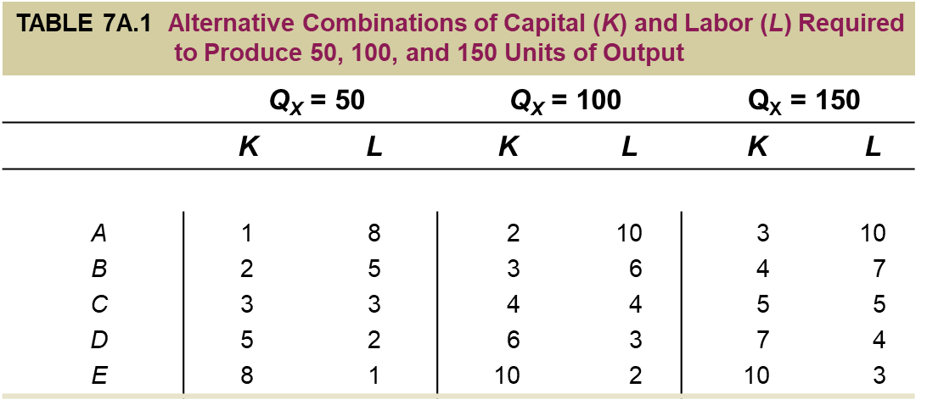
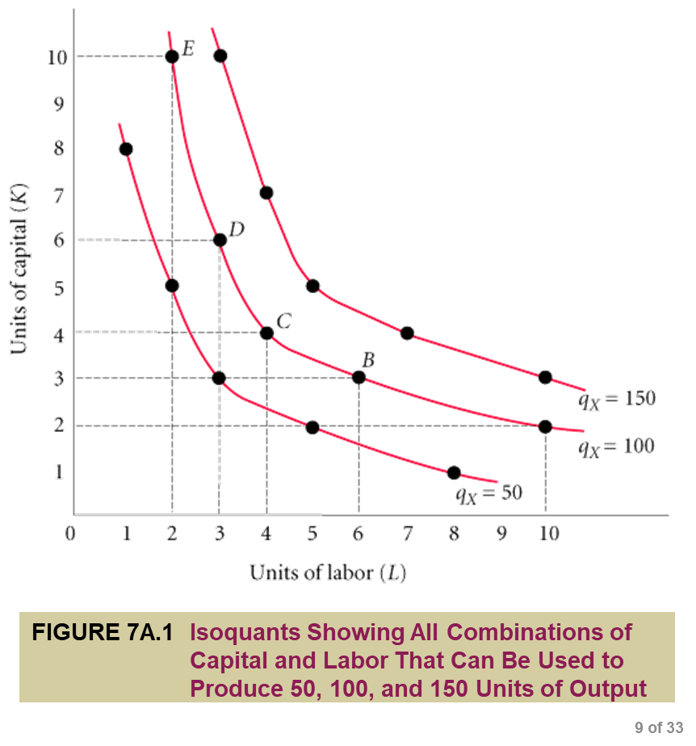
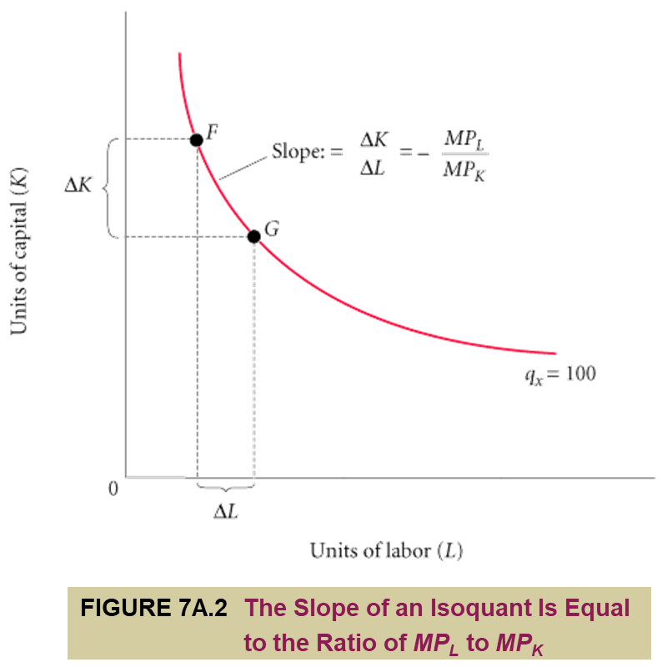
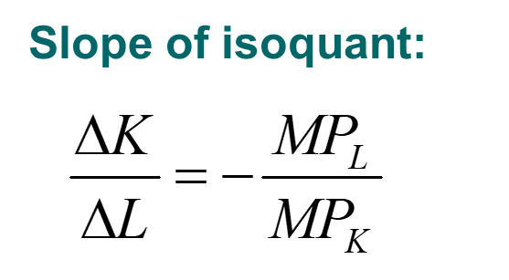
Isoquant
A graph that shows all the combinations of capital and labor that can be used to produce a given amount of output.
marginal rate of technical substitution
The rate at which a firm can substitute capital for labor and hold output constant.
<number> of 33

Slide 9
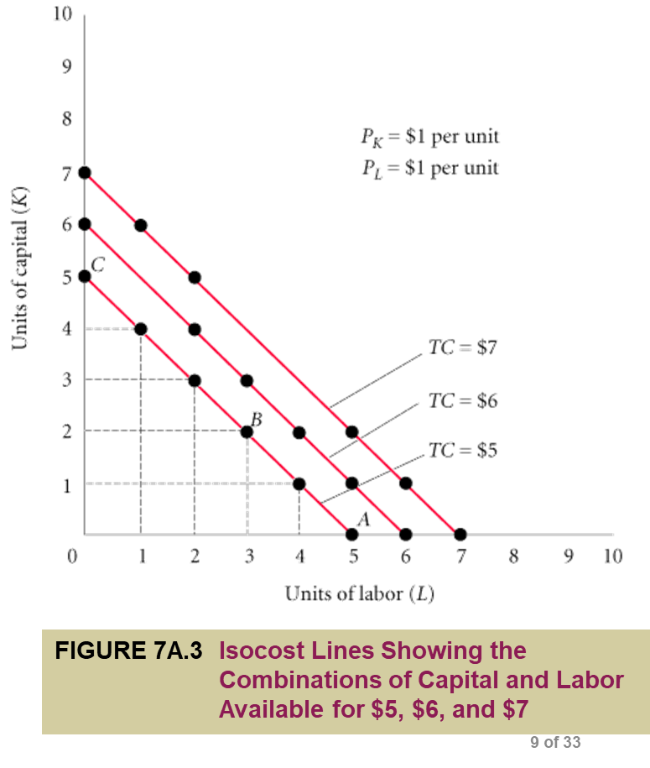
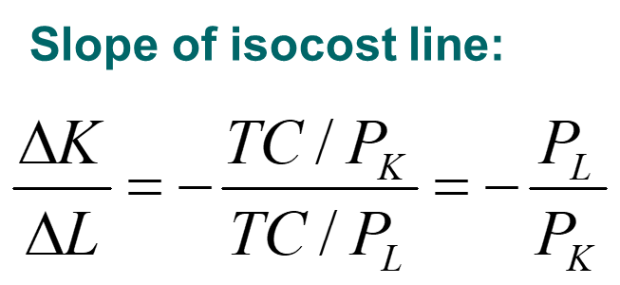
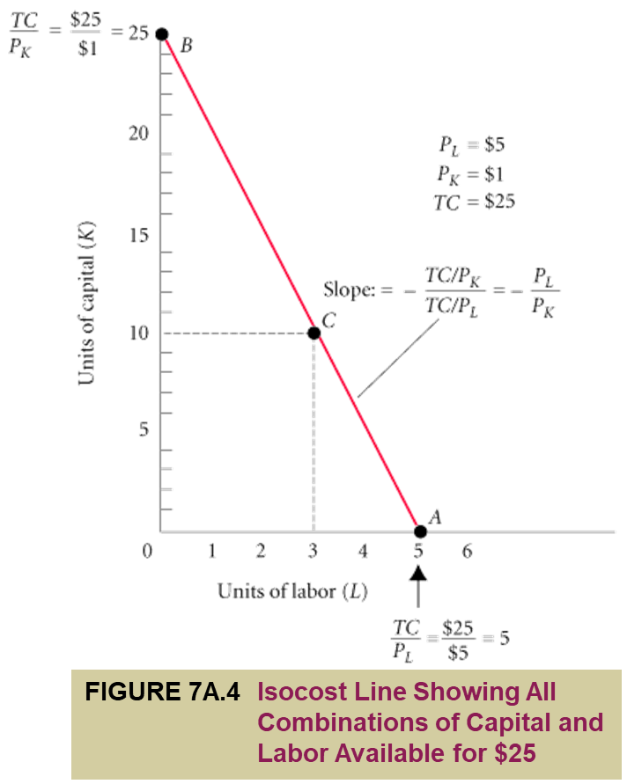
isocost line
A graph that shows all the combinations of capital and labor available for a given total cost.

Slide 10
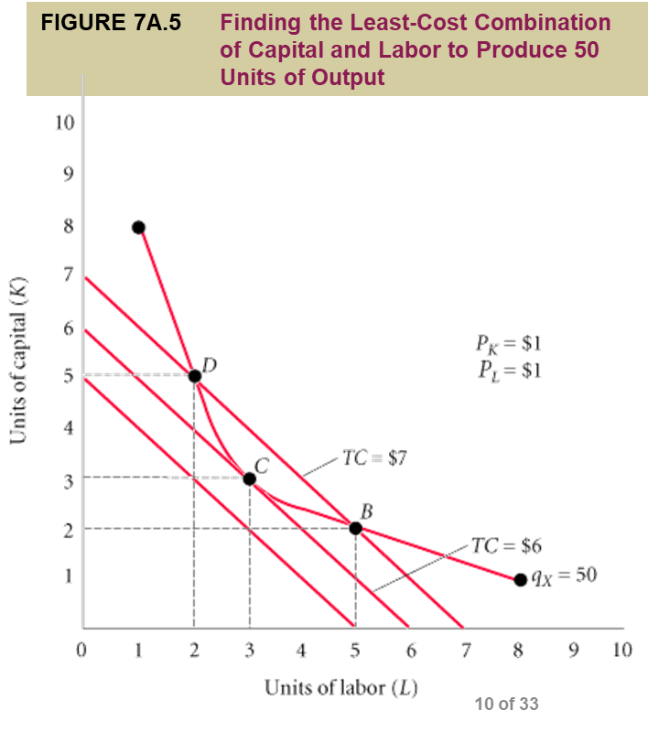
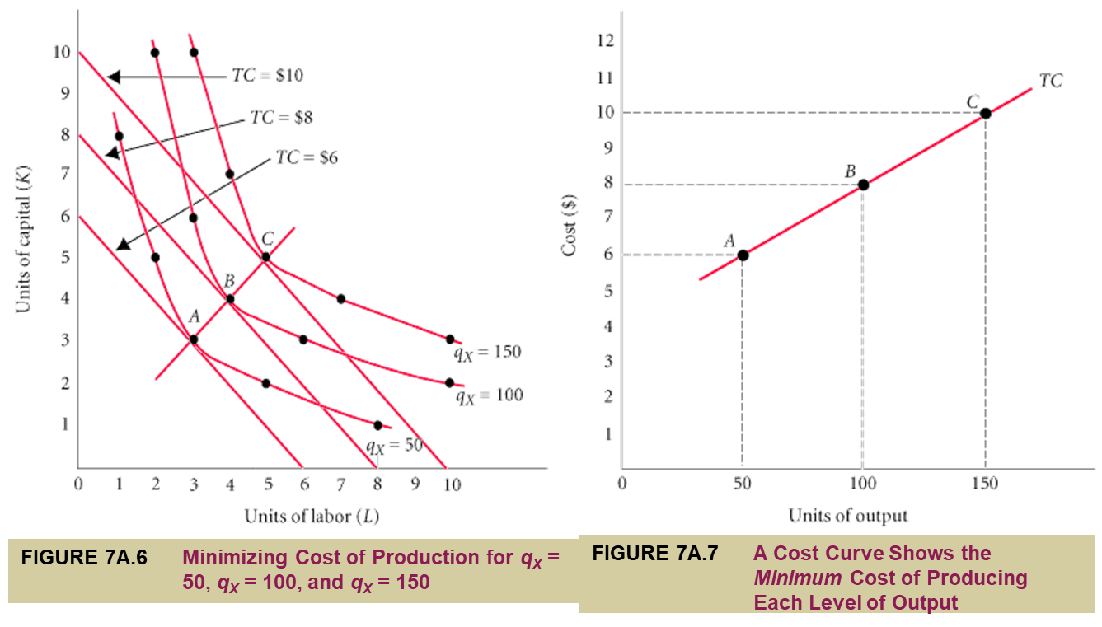
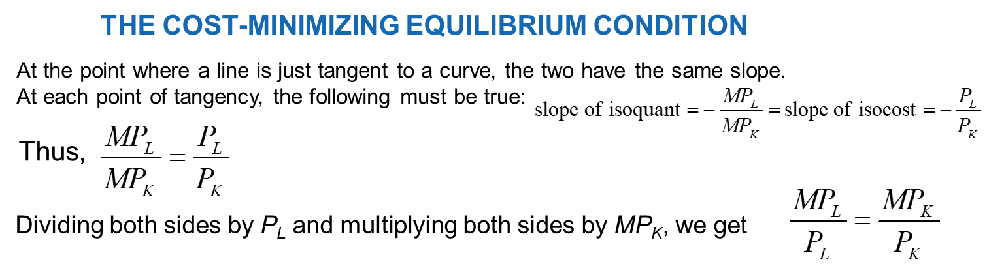
The firm will choose the combination of inputs that is least costly. The least costly way to produce any given level of output is indicated by the point of tangency between an isocost line and the isoquant corresponding to that level of output.

